Slide 1
Calculating a break-even point
Notes:
This presentation provides an overview of the key points in this chapter.
Note for tutors:
If you wish to print out these slides, with notes, it is recommended that, for greater clarity you select the ‘pure black and white’ option on the PowerPoint print dialogue box.

Slide 2

Tom can hire an ice-cream van for an afternoon
at a summer fete. The van hire will be Rs 100 and
the cost of cornets, ice cream etc will 50p per
ice cream.
Tom thinks a sensible selling price will be Rs 1.50.
At this price, how many ice-creams must he sell to cover his costs?
Calculating this will help Tom to decide if the idea
is worthwhile.
Notes:
This slide provides a practical example to illustrate why break-even charts can be useful. Even at the start, students should appreciate that if the break-even point is high (eg 500 ice creams to break even) the project is far more risky than if the break-even point is low (eg 50 ice creams to break even).

Slide 3
The basics of break-even analysis 1
Businesses must make a profit to survive
To make a profit, income must be higher than expenditure (or costs)
Income £50,000 Costs £40,000
Profit £10,000
Income £50,000 Costs £60,000
Loss £10,000
Notes:
This first slide gives the basics, together with an example of a profit and a loss. Students should realise that no business can survive making a loss for any length of time (in the short term, they could perhaps borrow if overall prospects were good).

Slide 4
The basics of break-even analysis 2
There are two types of costs:
Variable costs increase by a step every time an extra product is sold (eg cost of ice cream cornets in ice cream shop)
Fixed costs have to be paid even if no products are sold (eg rent of ice cream shop)
Notes:
Students should understand that costs are incurred in every business. The student handbook gives the example of a pizza outlet that has to heat the building and pay business rates even if hardly anyone comes for a meal. Every person who buys a meal causes additional costs because of the ingredients in the food eaten.

Slide 5
The break-even point
Variable + fixed costs = total costs
When total costs = sales revenue, this is called the break-even point, eg
  total costs = £5,000
  total sales revenue = £5,000
At this point the business isn’t making a profit or a loss – it is simply breaking even.
Notes:
The total amount of income received by a business should be greater than – or at least equal to – the total of the fixed and variable costs. The break-even point indicates when the two are the same.

Slide 6
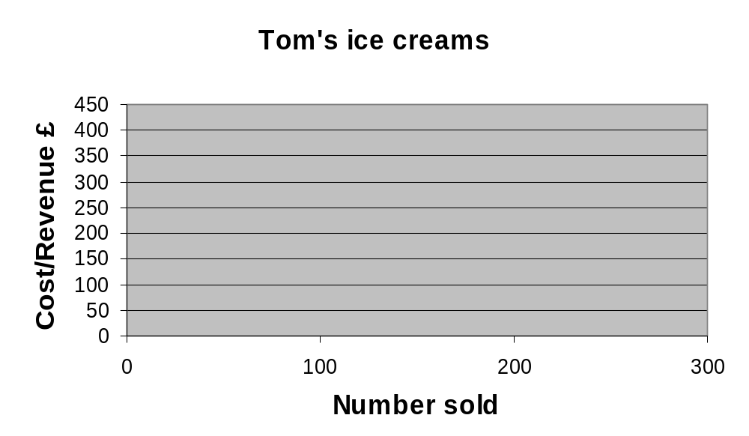
Drawing a break-even chart 1
Notes:
Students will have to be told that, in the time available, Tom thinks the highest number of ice-creams he could sell is 300. This has determined the horizontal line (axis) on the chart
Tom therefore knows that at £1.50 each, his maximum sales revenue will be £450. This determines the vertical line (axis) on his chart.

Slide 7
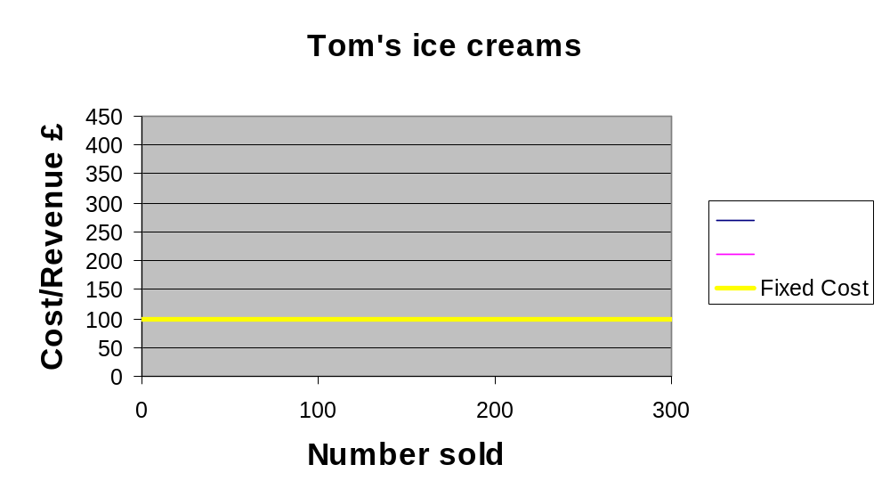
Drawing a break-even chart 2
Notes:
The first line drawn is for fixed costs. It is horizontal because the fixed cost figure (the van hire) is the same no matter how many ice creams are sold.

Slide 8
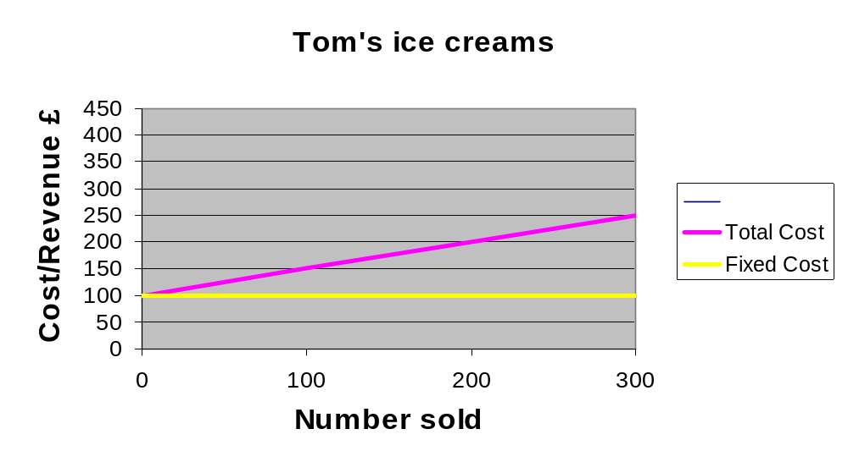
Drawing a break-even chart 3
Notes:
Tom’s variable costs are 50p per ice cream. This cost line starts at the point where the fixed cost line meets the vertical axis. Since it starts at this point, it represents the total cost of the product for any given level of sales.

Slide 9
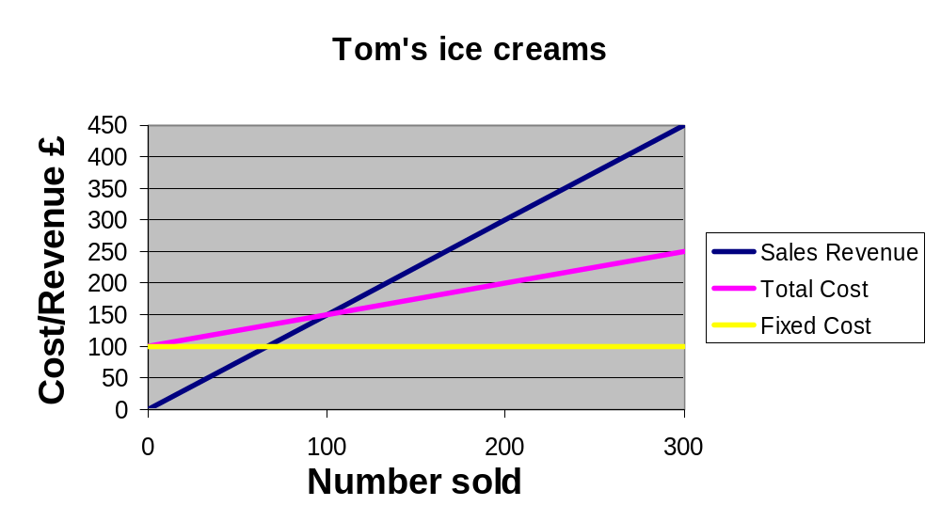
Drawing a break-even chart 4
Notes:
Finally, Tom draws in his sales revenue line. It starts at zero since if there are no sales, there will be no income.

Slide 10
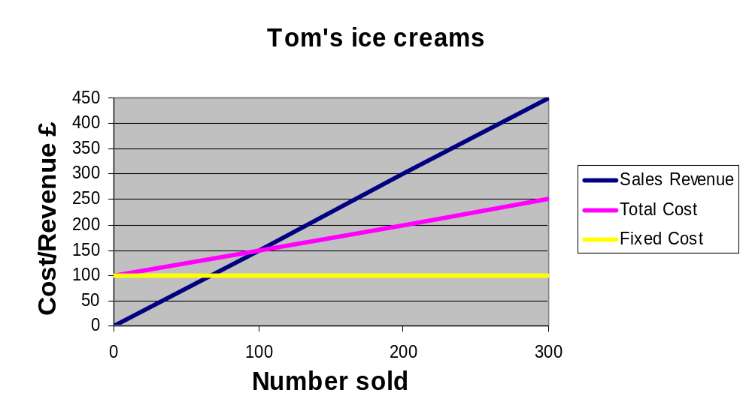
Identifying the break-even point
Profit
Loss
Break-even point
Notes:
The point at which the revenue line crosses the total cost line is called the break-even point. This is found by drawing a line vertically downwards to the horizontal axis. The distance between the total cost line and the revenue line shows the loss which would be made at that level of sales. After the break-even point, the difference between the two lines represents profit. From the graph, students should be able to calculate that Tom will lose £100 if he sells no ice-cream, yet could make a maximum profit of £200. In addition, as 100 ice-creams is a reasonable number to sell, the venture is worthwhile. The situation would be different if it was a rainy day and his break-even point had been 200 ice-creams!

Slide 11
Examples of costs
These vary, depending upon the type of business. Typical costs include:
Variable: materials, labour, energy
Fixed: rent, business rates, interest on loans, insurance, staff costs (e.g. security)
Notes:
Each cost could be discussed briefly in turn, emphasising why they are either fixed or variable. The difference between labour (variable) and staff (fixed) will need some explanation. Examples such as temporary labour used to cover busy periods versus admin staff who have no direct connection with the level of activity could be used to illustrate the point.

Slide 12
Using a formula to calculate the break-even point
The break-even point =
Fixed costs
(Selling price per unit minus variable cost per unit)
Notes:
Students obviously need to be familiar with the appearance of the formula. The next stage is to practice using actual figures. Tutors may wish to ask students to apply Tom’s figures to the formula before showing the next slide. NB: Tom’s fixed costs were £100, his selling price per ice cream was £1.50 and his variable costs per ice cream were 50p.

Slide 13
Applying the formula
Fixed costs
(Selling price per unit minus variable cost per unit)
Tom: 100
(1.50 – .50)
= 100
Notes:
Students should note that using the formula is a quick method of calculating the break-even point, compared to drawing a chart. However, this calculation does not indicate how much profit or loss would be made for a particular level of sales.

Slide 14
Assumptions in BE Analysis
Costs can be classified into fixed and variable costs, thus ignoring semi variable costs.
Selling price of the product is assumed constant.
It assumes constant rate of increase in variable costs.
It assumes no improvement in technology and labour efficiency.
Production and sales are synchronized.

Slide 15
Uses
It helps in determining optimum level of output below which it would incur loss.
It helps in determining the target capacity for a firm to get the benefit of minimum unit cost of production.
It helps in deciding which product to be produced and which to be bought by firm.
Plant expansion or contraction decisions are often based on BEA of the perceived situation.
Impact in changes in prices and costs on profits can also be analyzed.
Decisions regarding dropping or adding a product.
It evaluates financial yields, hence helps in choice between various alternatives.
Helps in identifying the selling price of a product.

Slide 16
Contribution Margin
In cost-volume-profit analysis, a form of management accounting, contribution margin is the marginal profit per unit sale.
It is the difference between total revenue- total variable cost.
TCM= TR-TVC
Net profit + Fixed costs
If Net profit =0, then, TCM=TFC and hence BEP.
Average contribution margin= unit price- avg. variable cost
Break even occurs when, ACM= AFC

Slide 17
Contribution margin can be thought of as the fraction of sales that contributes to the offset of fixed costs.
Alternatively, unit contribution margin is the amount each unit sale adds to profit

Slide 18
A manufacturer sells his product at Rs. 5each, variable cost are Rs. 2/unit and the fixed amount of Rs. 60000,
  Calculate the BEP
  What would be the profits if firm sells 30000 unit.
  What would be the BEP if firms spends Rs. 3000 on advertising.
  How much the manufacturer sell to make profits of Rs. 30000.

Slide 19
Comparison of Alternatives
BE analysis can be used for comparing different alternatives that are available for producing a particular product.
These differ in terms of costs associated with them at different levels of output.
Example at lower levels of output manual operated techniques may be profitable (because of minimum FC) and not profitable at higher outputs because of higher VC.

Slide 20
Thus solve with costs associated with different alternatives and determine the range of output where each alternative will be economical.
TC of Alt 1
TC of Alt 2
Costs
TC of Alt 3
Q1
Q2
Q3
Units of Output

Slide 21
Steps involved in determining break even
Define the common variable and its dimensional unit
Use AW or PW analysis to express the total cost of each alternative as function of common variable.
Equate the two relations and solve for break even value
If the anticipated level is below the breakeven value then select alternative with higher variable cost and otherwise

Slide 22
Numerical 1
A 50 HP motor is required to drive a pump to remove water from a tunnel. The unit will be needed for a period of 4 years.
Two alternatives are under consideration.
Alternative A calls for the construction of a power line and purchase of the electric motor at a total cost of $4900. The salvage value of this equipment after 4 years is estimated to be $700.
The cost of the current for the per hour of the operation is estimated to be $2.94 and the maintenance is estimated as $420 per year.
Alternative B calls for purchase of diesel engine pump set at a cost of $1925 and it will have no salvage value at the end of 4 years period. The cost of diesel per hour of operation is estimated at $1.47 maintenance is estimated at $0.53 per hour operation and the cost of wages chargeable when the engine runs is $2.8 per hour.
How many hours per year the two machines have to run so that the two alternatives incur equal costs. If the no. of hours of operation is estimated at 100 hours which alternative is more economical. Take interest rate at 10% per year.

Slide 23
Let x be the no. of hours of use of the operation per year
TC_{a} is total equivalent annual cost of ALT A
TC_{b} is total equivalent annual cost of ALT B
TC_{a} = Capital Recovery + Maintenance cost per year + Current cost per year
TC_{a} = (P-S)(A/P, I, n) +Si+ 420+2.94x
=(4900-700)(A/P,I,n) +700*0.1+420+2.94x = 1815+2.94x
TC_{b} = (1925-0) (A/P, 10%, 4) +.10*0+(1.47+0.53+2.8)*x
TC_{b} = 607.28 +4.8 x
607.28+ 4.8x = 1815+2.94x
X= 649 hours

Slide 24
Numerical 2
A contractor is offered his choice of either gasoline, diesel or butane engine to power a bulldozer he is to purchase.
The gasoline engine will cost $2000 and will have a estimated maintenance cost of $200 per year and will consume $3.6 worth of fuel per hour of operations.
The diesel engine will cost $2,800 and will cost an estimated $240 per year to maintain and will consume $3.30 worth of fuel per hour.
The butane engine will cost $3,300 and will cost $315 per year to maintain and will consume $2.9 worth of fuel per hour of operation.
Since the salvage value of the engine is identical it can be neglected. All other costs associated with the three engines are equal and the interest rate is 15%. The service life of each engine is 5 years.
Plot the total annual cost of each engine as a function of no. of hours of operation/year.
Find the range of no. of hours of operation for which it would be most identical to specify the gasoline, diesel and butane engines.

Slide 25
Let x be the no. of hours of operations of each engines per year
TC1 = Total equivalent annual cost of gasoline engine
TC2 = Total equivalent annual cost of diesel engine
TC3 = Total equivalent annual cost of Butane engine
TC1= 2000(A/P, 15%, 5)+ 200 +3.6x
TC2 = 2800(A/P, 15%,5) +240+3.3x
TC3 = 3300(A/P, 15%,5) +315+2.9x
TC1 = TC2
X= 729 hours
TC2=TC3,
X= 516 hours
TC3= TC1,
X = 719 hours

Slide 26
Thus solve with costs associated with different alternatives and determine the range of output where each alternative will be economical.
TC of Alt 1
TC of Alt 2
Costs
TC of Alt 3
Q1
Q2
Q3
Units of Output

